Slide 1

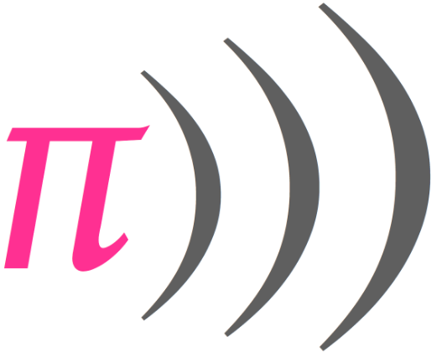
Making A Song In Sonic Pi

Slide 2
Learning Objectives
Learn to use the synth options
Learn to use the sample options and effects

Slide 3
Tweaking the sound
Let's look into synth options, sample options and effects to spice our song some more.
So far you have learned how to use attack, release, and cutoff options after a play command. Lets look at the options (opts in short). They are controls passed to play to modify and control the aspects of the sound. Each synt has it own sets of options but there are lots of common options that work across many sounds.
Options
  Amp: Amplitude is the loudness of a sound. 0 is silent while 1 is the normal volume. High amplitudes make the sound muddy and strange. Use low amps between 0 to 0.5.
  Pan: Pan controls the panning of a sound in stereo. -1 means that you hear it out of the left speaker, 1 means you hear it out of your right speaker and 0 is center. You can use any value between -1 and 1. Random pan values can be used for your hi-hats to add some texture.
  Cutoff: Removes frequencies higher that the given value. Use values between 0-130.

Slide 4
Tweaking the sound
Beat_stretch: Used to stretch/shrink the sample:
live_loop :amen_break do
sample :loop_amen, beat_stretch:2 (This makes the sample 2 beats long)
sleep 2
end
  Rate: Rate controls how fast a sample is played. 1 is in original speed, 0.5 is in half speed and 2 is in double speed. The sample also sounds higher and lower pitched when you change the rate. Negative values play the samples backwards. See example below:
live_loop :amen_break do
sample :loop_amen, beat_stretch:2, rate: -1
sleep 2
end

Slide 5
Adding effects (with_fx)
with_fx: powerful tool for adding different effects to your composition.
  There are lots of effects but lets try :reverb; it sounds just nice.
The code would look something like:
live_loop :effects do
with_fx :reverb do
play 50
sleep 0.5
sample :elec_plip
sleep 0.5
play 62
end
end

Slide 6
Adding effects (with_fx)
Like synths and samples, effects also have options:
Here are just a few and what they do.
  mix: is an option that sets how much the effect and the original sound is heard.
  mix: 0 plays only the original sound.
  mix: 1 plays only the FX.
  :room Try different room sizes with values between 0-1.

Slide 7
Adding Effects
Example:
live_loop :effects do
with_fx :reverb, mix: 0.5, room: 0.9 do
play 50
sleep 0.5
sample :elec_plip
sleep 0.5
play 62
end
end
Note: If you open the ‘Fx’ tab on the help menu you can find what options are available for which FX.

Slide 8
Nesting effects
Nesting means adding more effects in your loop; there is no limit of the number of effects to use.
Example:
live_loop :effects do
with_fx :wobble do
with_fx :slicer do
with_fx :reverb do
play 50
sleep 0.5
sample :elec_plip
sleep 0.5
play 62
end
end
end
end

Slide 9
Sources and References
http://sonic-pi.mehackit.org/exercises/en/01-introduction/01-introduction.html
http://sonic-pi.net/

